Slide 1
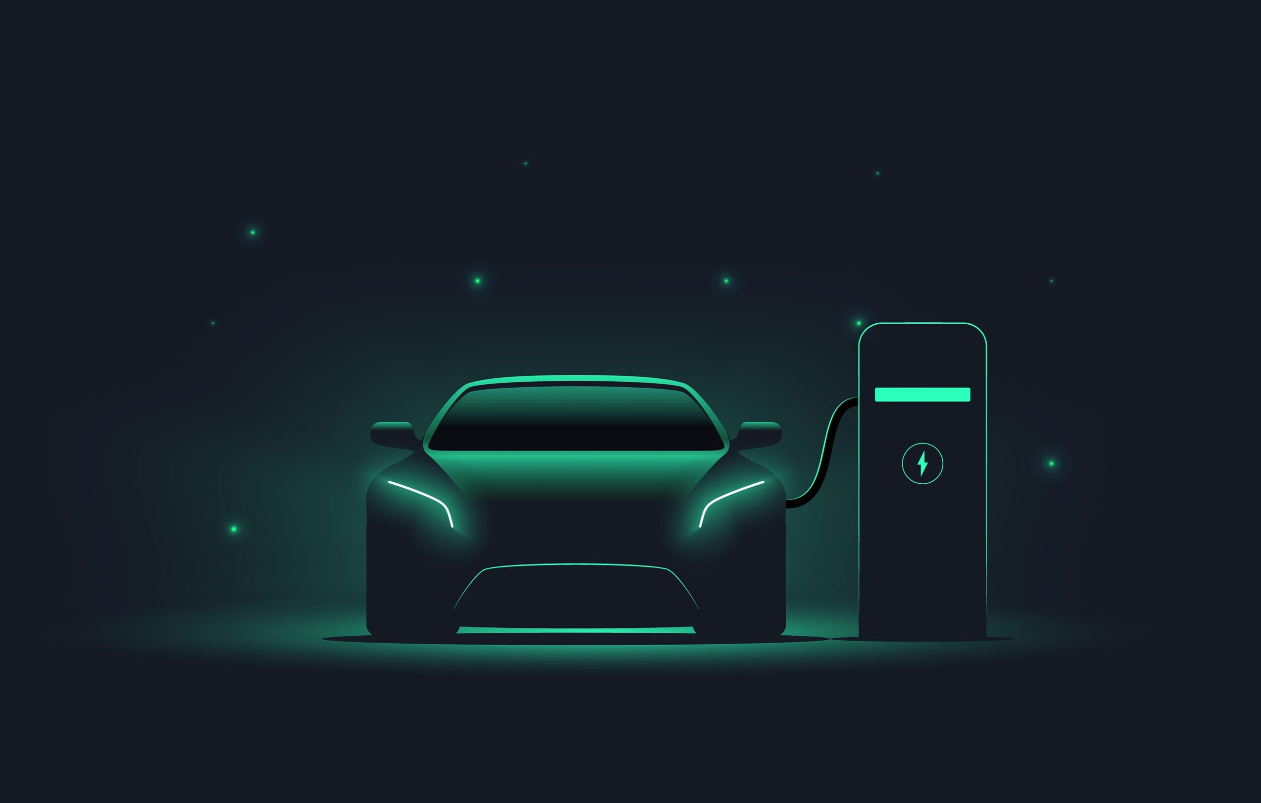
AtliQ motors
India is charging ahead towards a greener future, accelerating its adoption of electric vehicles for a sustainable tomorrow

Slide 2

AtliQ motors
Provide Insights to an Automotive company on Electric vehicles launch in India
AtliQ Motors is an automotive giant from the USA specializing in electric vehicles (EV). In the last 5 years, their market share rose to 25% in electric and hybrid vehicles segment in North America. As a part of their expansion plans, they wanted to launch their bestselling models in India where their market share is less than 2%. Bruce Haryali, the chief of AtliQ Motors India wanted to do a detailed market study of existing EV/Hybrid market in India before proceeding further

Slide 3

Goal of this project
Analyze the Indian EV/Hybrid market using data-driven insights to identify key opportunities and challenges, providing actionable recommendations to help AtliQ Motors increase its market share in India.

Slide 4
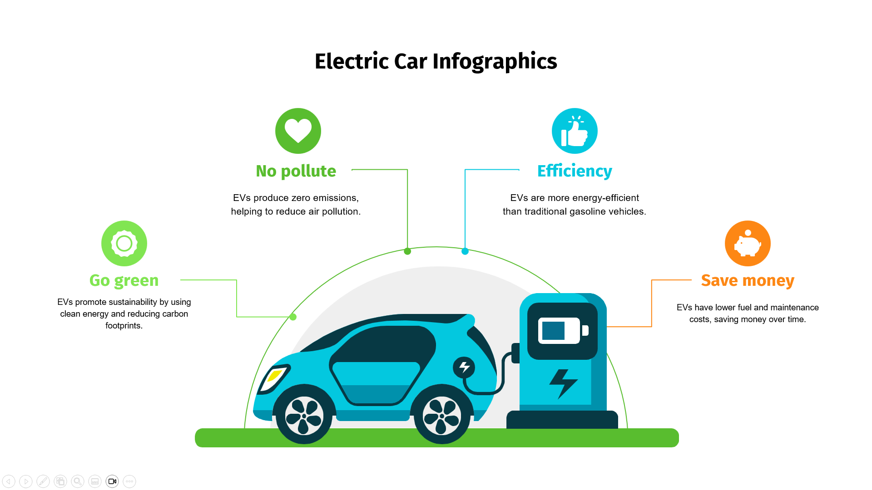

Slide 5
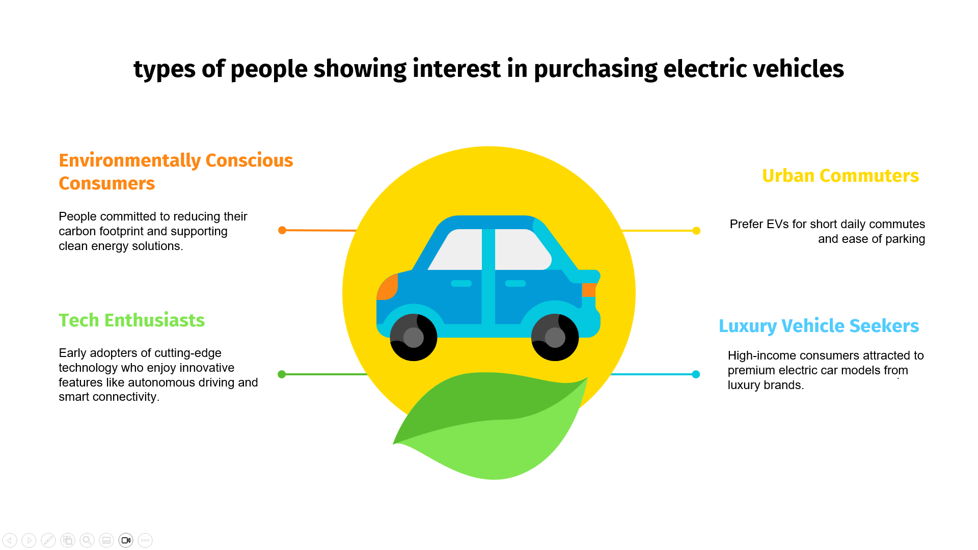

Slide 6
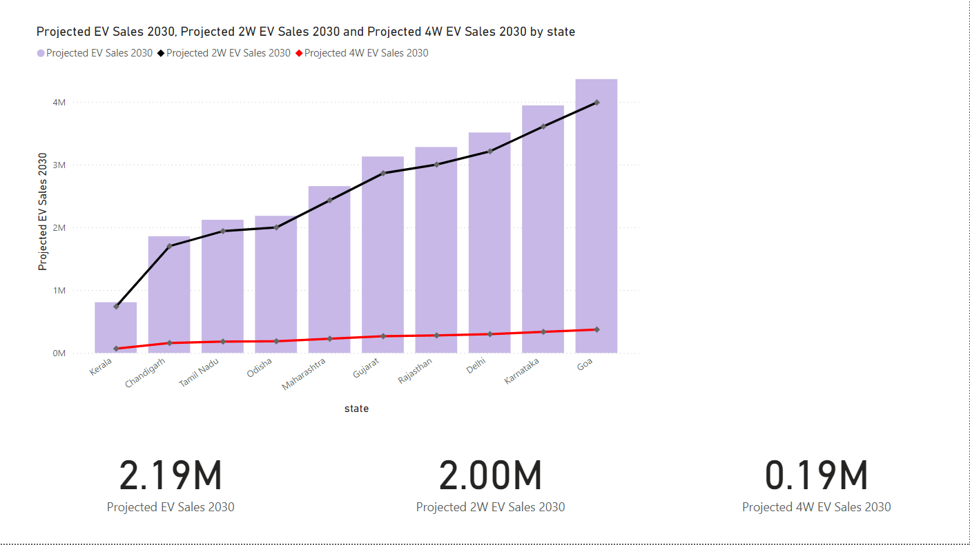
What is the projected number of EV sales (including 2-wheelers and 4 wheelers) for the top 10 states by penetration rate in 2030, based on the compounded annual growth rate (CAGR) from previous years?

Slide 7
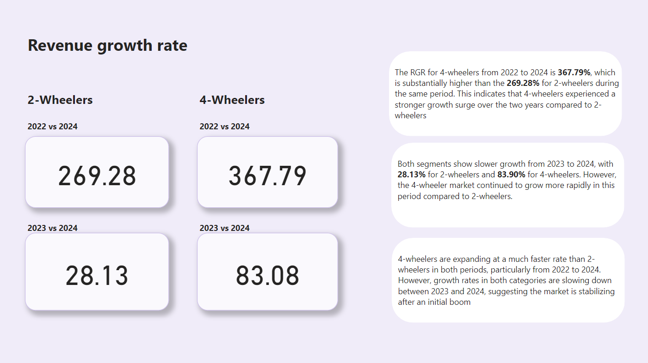
Estimate the revenue growth rate of 4-wheeler and 2-wheelers EVs in India for 2022 vs 2024 and 2023 vs 2024, assuming an average unit price. H

Slide 8

What are the primary reasons for customers choosing 4-wheeler EVs in 2023 and 2024
Cost Savings: The lower Total Cost of Ownership (TCO) of electric vehicles (EVs) compared to internal combustion engine (ICE) vehicles is a significant motivator. Despite higher upfront costs for 4-wheeler EVs, savings on fuel, maintenance, and long-term operating costs make them appealing, particularly to fleet buyers and businesses
Environmental Concerns: The increasing priority on environmental sustainability has driven the preference for EVs among consumers. The reduction in carbon emissions and heightened awareness of climate change have positioned EVs as the preferred choice for eco-conscious buyers globally, continuing to drive EV adoption
Government Incentives: Governments worldwide, including India, are offering substantial incentives to boost EV adoption. Initiatives such as tax rebates, subsidies, and programs like India’s FAME II initiative aim to support EV adoption through financial incentives and infrastructure development (Bain). In regions where there are penalties for ICE vehicles, the shift to EVs is further encouraged (EY US).
Together, these factors—cost savings, environmental responsibility, and government policies—are fueling the growth of the 4-wheeler EV market in 2023 and 2024.

Slide 9
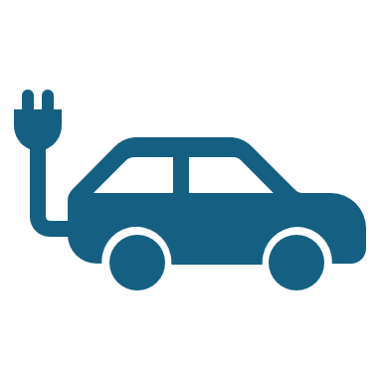
How do government incentives and subsidies impact the adoption rates of 2-wheelers and 4-wheelers? Which states in India provided most subsidies?
Government Schemes: Programs like FAME II have boosted EV adoption by providing subsidies for the purchase of 2-wheelers and 4-wheelers​
Higher Sales: States offering tax exemptions, road tax waivers, and subsidies have shown higher EV adoption rates​(
Subsidy Reductions: Recent cuts in subsidies for electric 2-wheelers under FAME II may slow down adoption as Indian consumers are price-sensitive​
Top States Offering Subsidies: Karnataka, Maharashtra, Gujarat, and Tamil Nadu are leading in providing incentives and have seen higher EV sales​

Slide 10
How does the availability of charging stations infrastructure correlate with the EV sales and penetration rates in the top 5 states?
Increased EV Adoption: States with well-developed charging infrastructure, such as Maharashtra, Tamil Nadu, Karnataka, Gujarat, and Rajasthan, have seen higher EV sales and penetration rates​
Reduced Range Anxiety: Expanding charging stations along highways and urban areas reduces range anxiety, encouraging more consumers to buy EVs
Fast-Charging Stations: States investing in fast-charging technology, like Maharashtra and Karnataka, see higher EV penetration due to quicker charging times for long-distance travel​
Private and Government Initiatives: Government programs like FAME II and private sector partnerships are key in developing charging infrastructure, which directly correlates with EV sales​

Slide 11
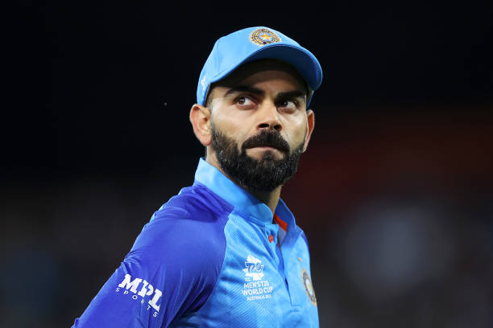
Virat kohli
Global Influence: Virat Kohli's worldwide recognition and fan following can expand the reach of the electric vehicle company beyond national boundaries.
Youth Appeal: As a youth icon, Virat Kohli's endorsement can resonate with the younger demographic, which is a key target audience for electric vehicles.
Positive Image: Known for his sportsmanship and leadership qualities, Virat Kohli's positive public image adds credibility and trustworthiness to the brand.
Brand Association: Aligning with Virat Kohli can enhance the electric vehicle company's brand value and perception in the market.
Market Penetration: Leveraging Virat Kohli's popularity can help penetrate new markets and increase brand visibility among diverse consumer segments.

Slide 12
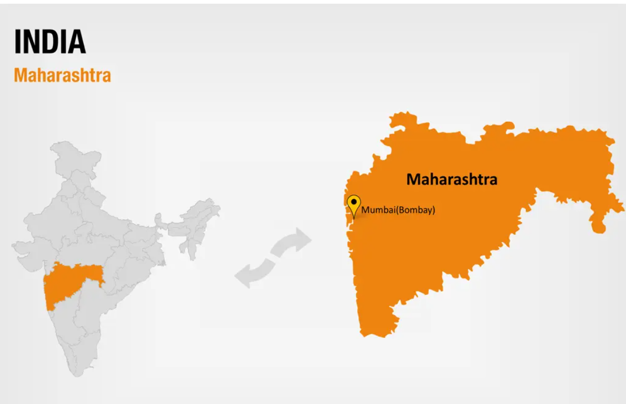

Slide 13

Infrastructure: Maharashtra has well-developed infrastructure, including ports, roads, and airports, facilitating smooth transportation and logistics.
Industrial Hub: With cities like Mumbai and Pune, Maharashtra is an established industrial hub with a skilled workforce and resources.
Market Potential: Being a populous state with strong purchasing power, Maharashtra offers a vast market for electric vehicles.
Government Support: The state government has shown a favorable stance towards electric vehicle adoption, offering incentives and policies to promote sustainable transportation.

Slide 14
Recommendations
1. Invest in Charging Infrastructure Development
Collaborate with government and private partners to set up a robust charging network.
2. Leverage Government Incentives and Policy Support
Utilize the FAME II scheme for subsidies on EVs, fleet electrification, and charging infrastructure.
3. Enhance Battery Technology and Local Manufacturing : Establish local battery manufacturing facilities to reduce costs and reliance on imports.
4. Build Awareness and Collaborate for Ecosystem Development Conduct awareness campaigns to educate consumers about the benefits of EVs.

Slide 15
Thank you

